Slide 1
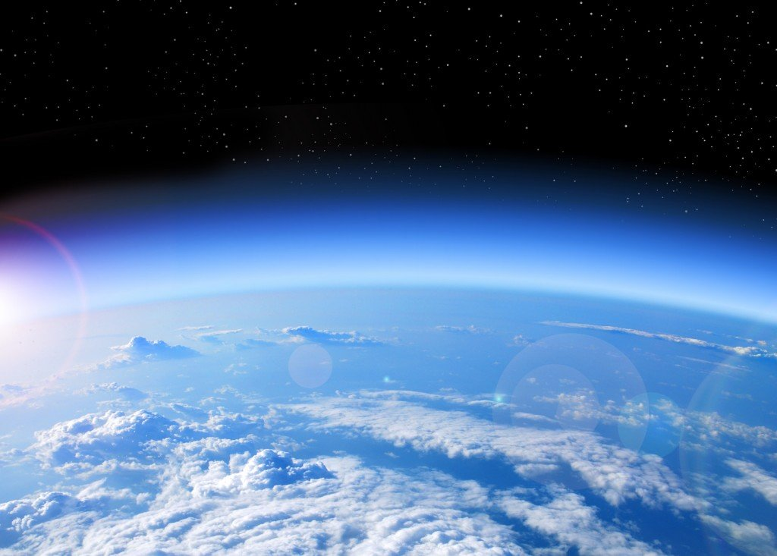
Spheres of the Earth

Slide 2
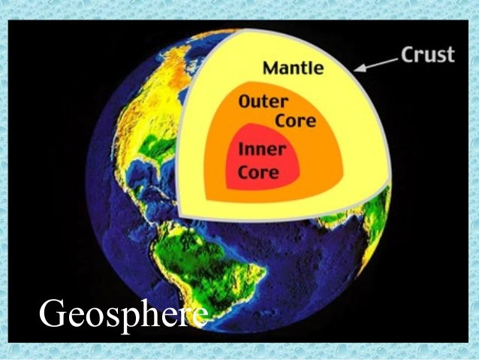
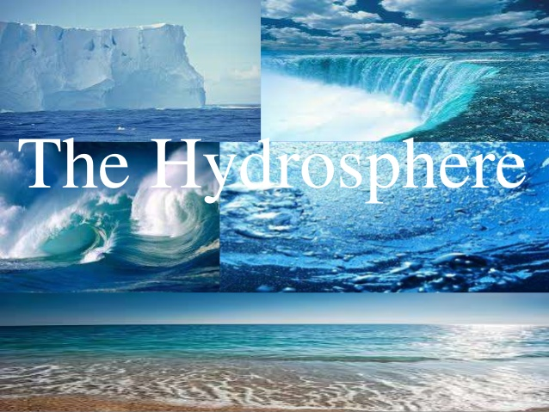
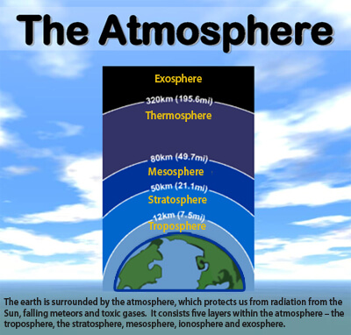
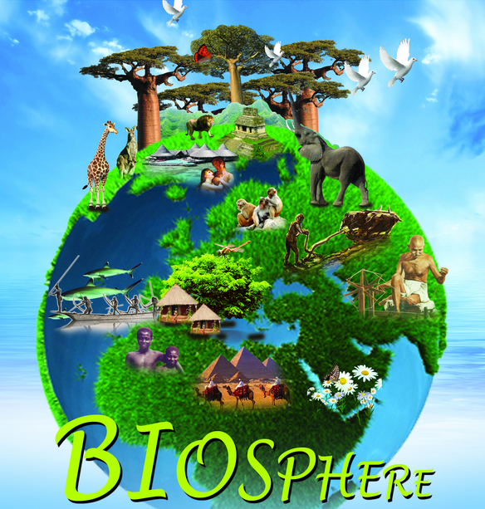
Earth Systems
Geosphere
All layers of the solid earth
Hydrosphere
All earth’s water
Atmosphere
Outermost system
Mixture of gases and particles
Biosphere
All living things
Within all other systems
On land, water, and air

Slide 3
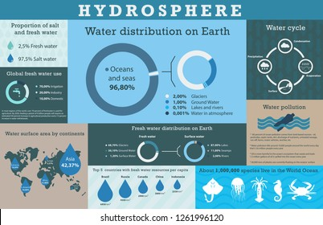
Hydrosphere
All Earth’s water

Slide 4
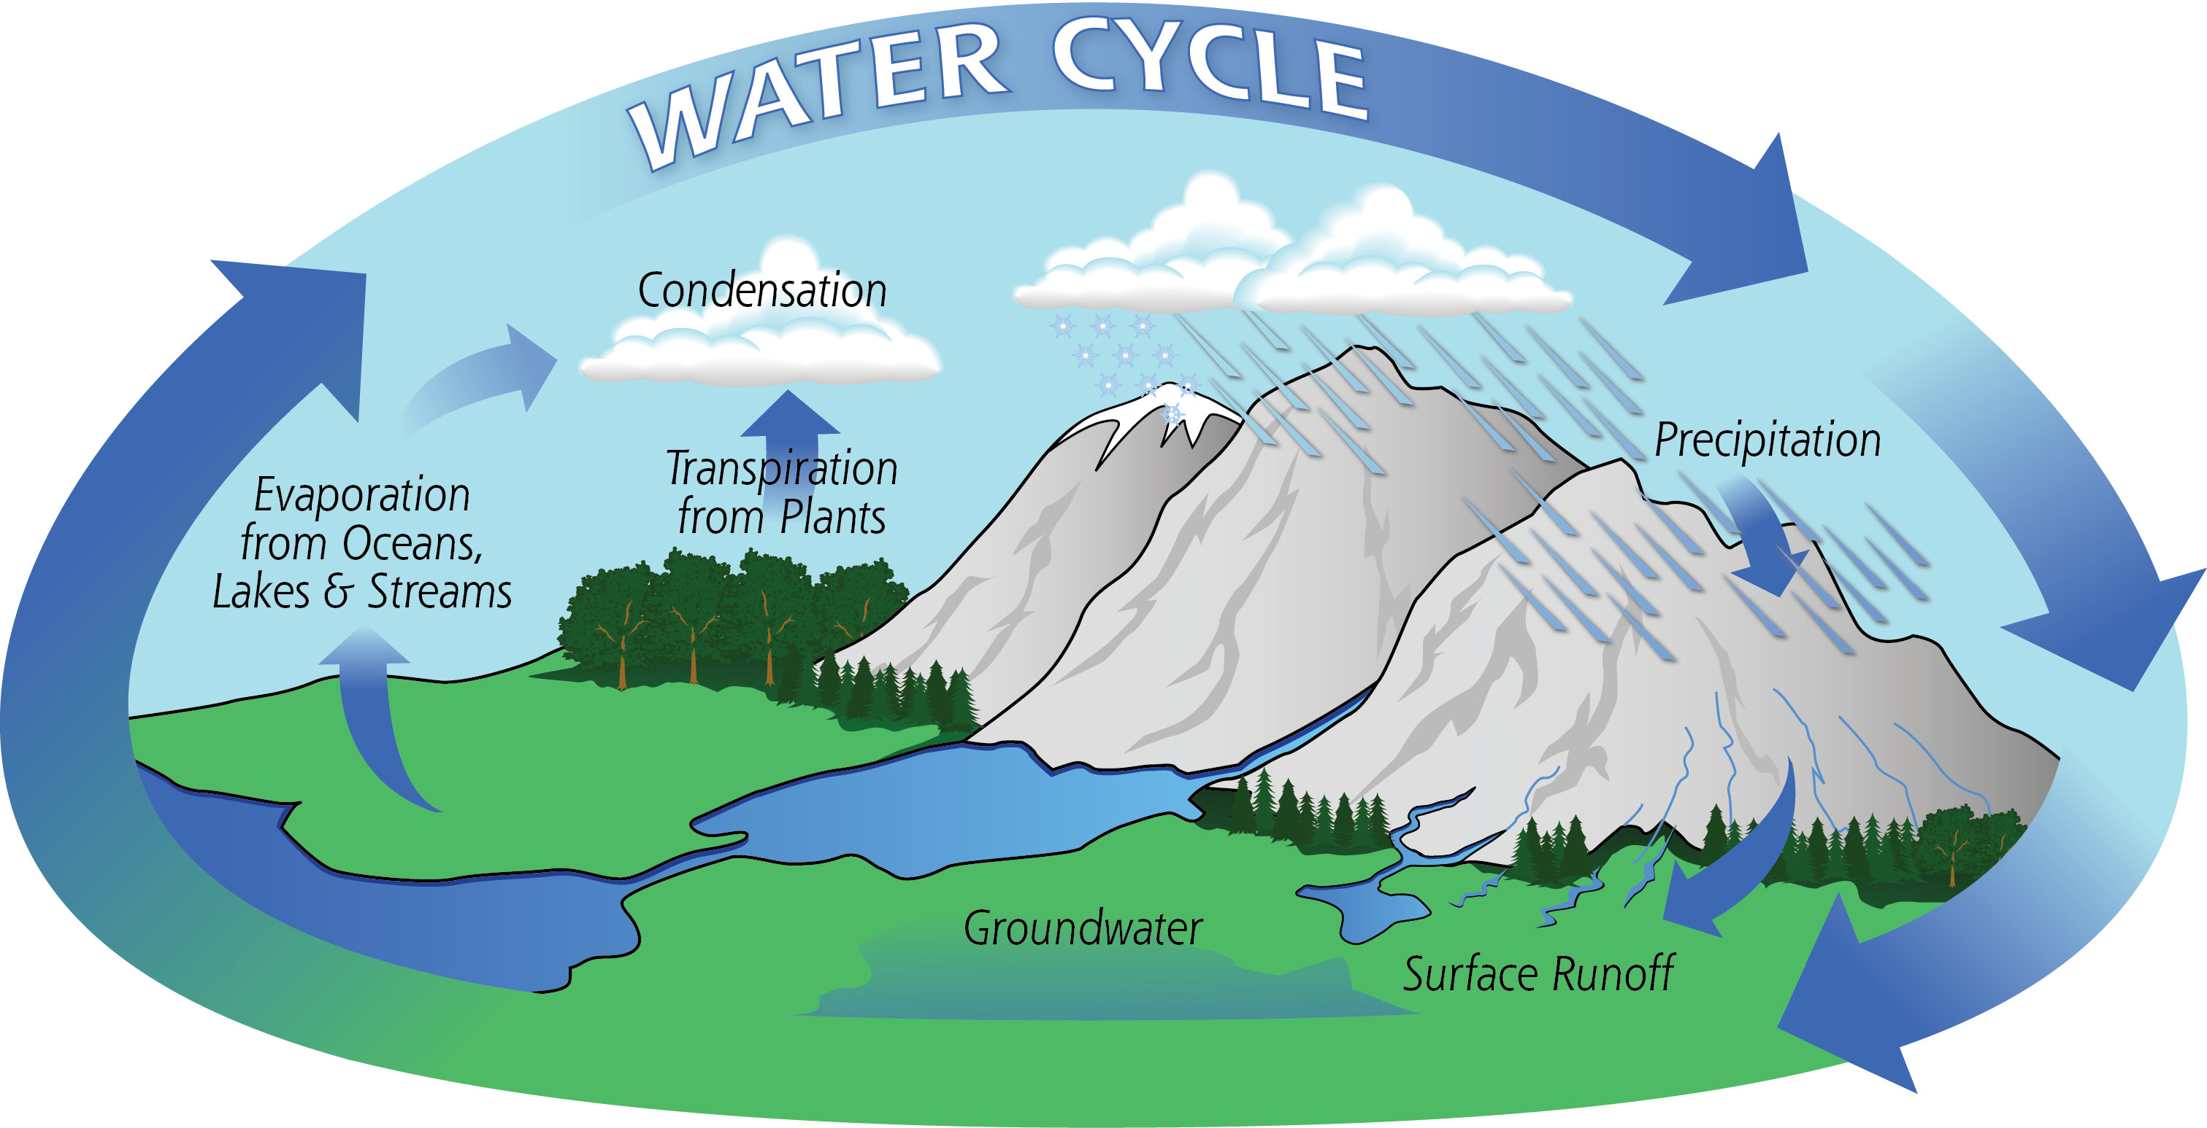

Slide 5
Hydrosphere
The Water Cycle
Condensation
Evaporated water changes from gas to a liquid
Gathers with dust to form clouds
Precipitation
Condensation and water falls to earth as rain or snow
Evaporation
Liquid water changes to a gas and rises into the atmosphere
Transpiration
Water evaporates out of plant leaves
Collection
Water collects as runoff or groundwater

Slide 7
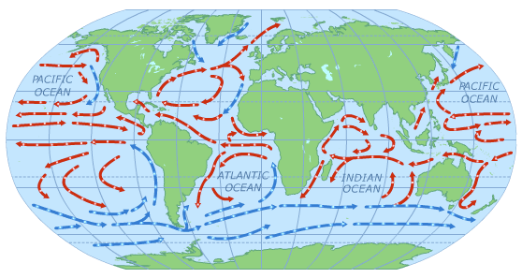
Ocean Currents
Ocean Currents--“Stream-like” movements of water
Surface Currents
Occur near the surface
Caused by wind
Depths of 100-1000 meters

Slide 8
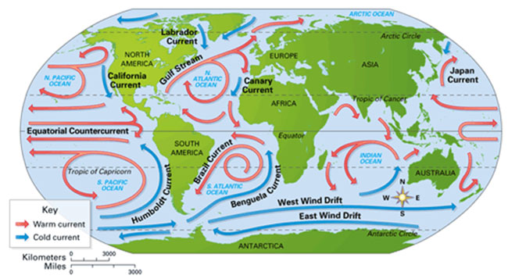
Ocean Currents
What Affects Surface Currents?
Continental Deflections
Currents change direction when they meet continents

Slide 9
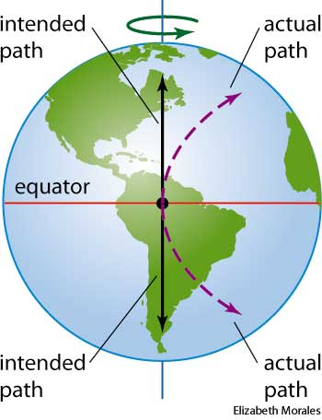
Ocean Currents
What Affects Surface Currents?
Coriolis Effect
Earth’s rotation causes moving air and water to appear to move to the right in the northern hemisphere and to the left in the southern hemisphere

Slide 10
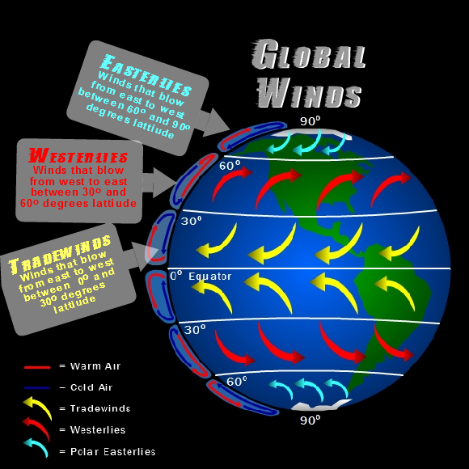
Ocean Currents
What Affects Surface Currents?
Global Winds
Winds that blow across the surface of Earth’s oceans push water across Earth’s surface

Slide 11
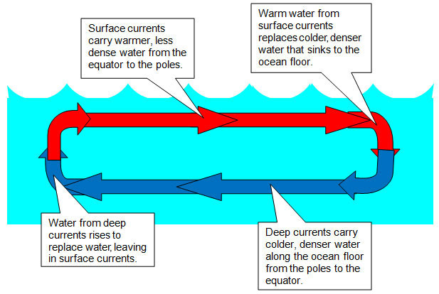
Ocean Currents
What Powers Ocean Currents?
The Sun
Heats up water at the Equator
Gravity
Warm, less dense water goes up
Cold, more dense water goes down

Slide 12
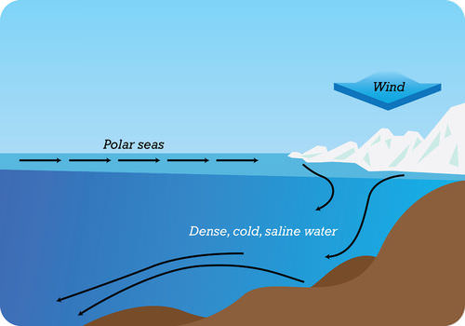
Ocean Currents
Deep Currents
Occur far below surface
Caused by differences in water density
Salinity
More salt, more density
Temperature
Colder temperature, more density

Slide 13
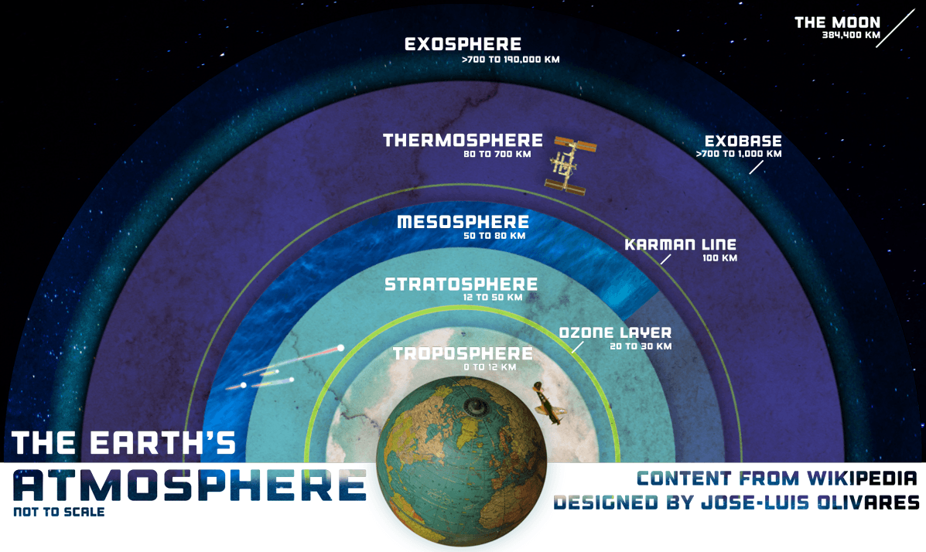
Atmosphere
A thin layer of gases surrounding Earth

Slide 14
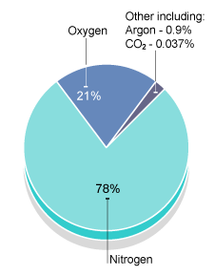
Atmosphere
Composition
Gases
Nitrogen=78%
Oxygen=21%
Other gases-
(water vapor, argon, carbon dioxide)=1%
Solids and Liquids
Dust, pollen, salt, volcanic ash
Water droplets, acids

Slide 15
Atmosphere
Importance
Contains oxygen, carbon dioxide, and water necessary for life
Keeps Earth’s temperatures within a survivable range
Protects living things from Sun’s harmful rays
Protects Earth’s surface from being struck by meteors

Slide 16
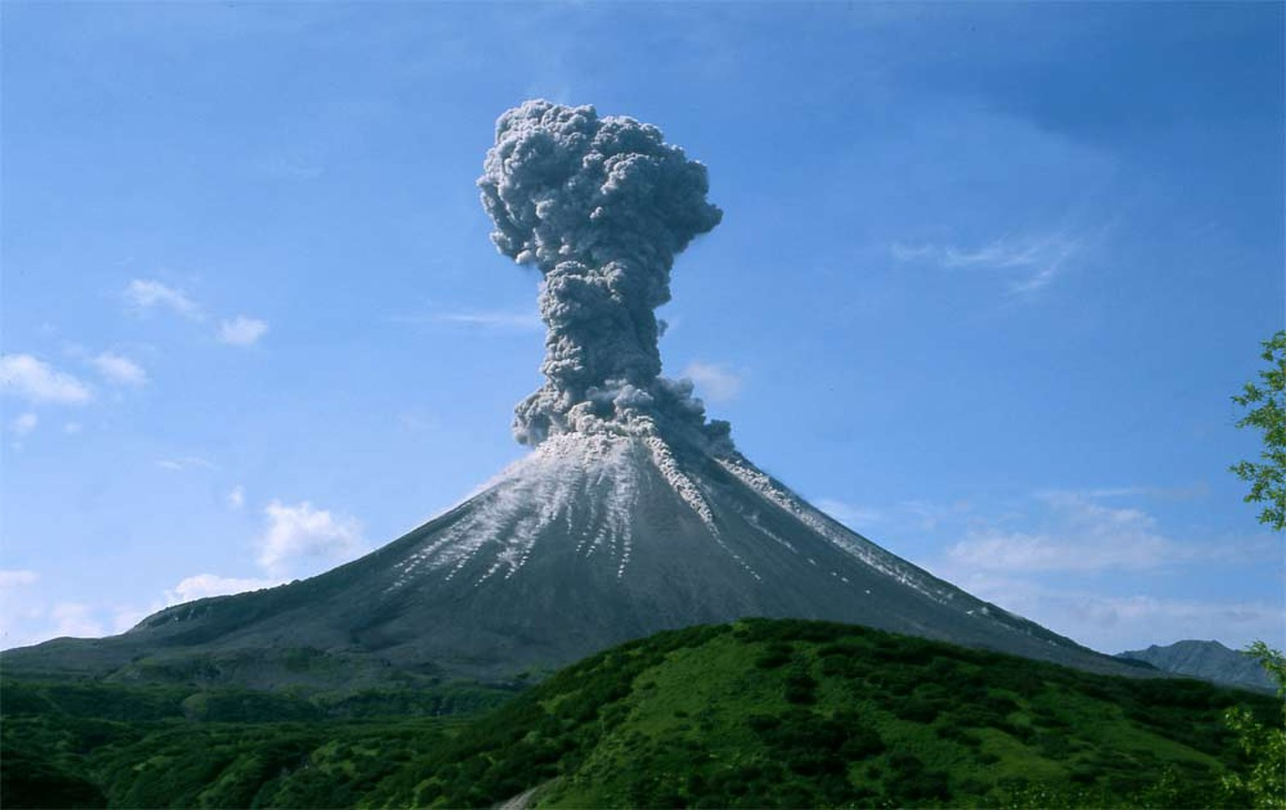
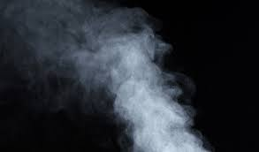
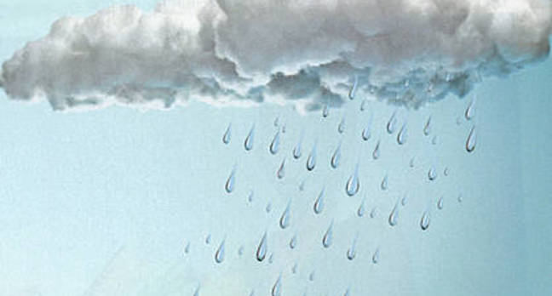
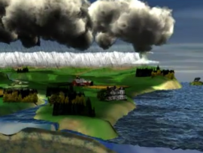
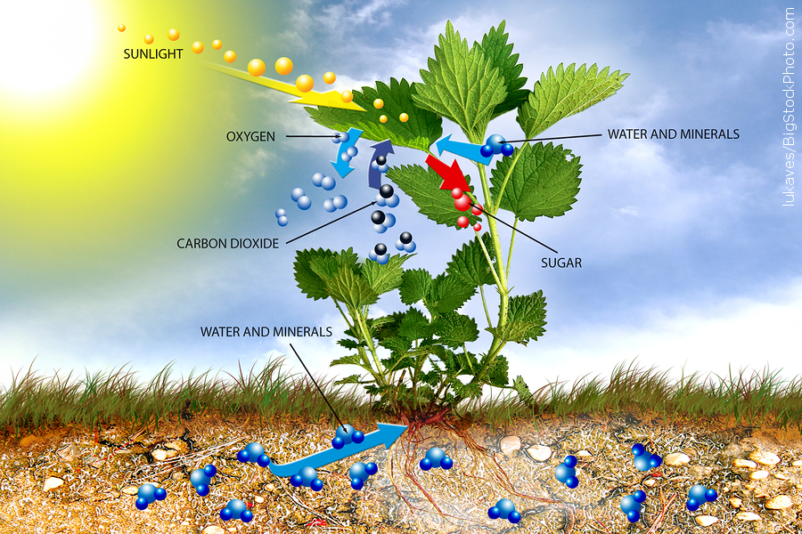
Atmosphere
Origin
Gases from erupting volcanoes on early Earth emitted hot gases, gases formed atmosphere
Early atmosphere was mostly water vapor
As Earth cooled, water vapor condensed and fell in liquid form
Water cycle occurred for thousands of years
First organisms used photosynthesis, removing CO₂ and giving off O₂

Slide 17
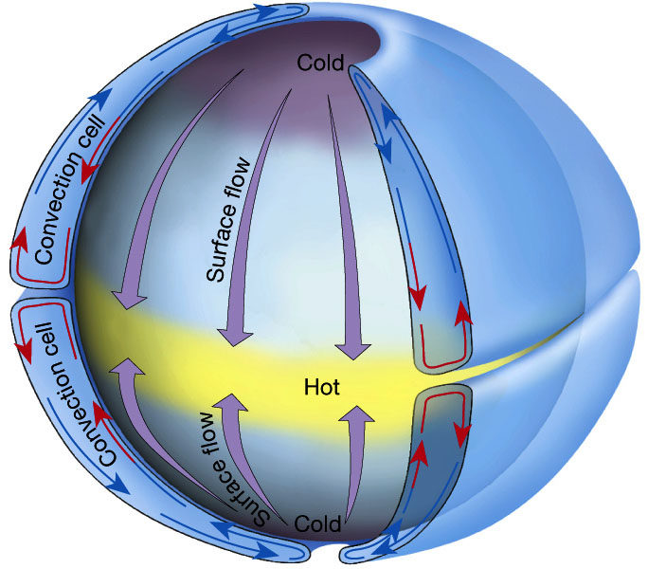
Atmosphere
Circulating Air
Affects weather and climate around the world
Warm, less dense air rises
Cool, more dense air sinks

Slide 18
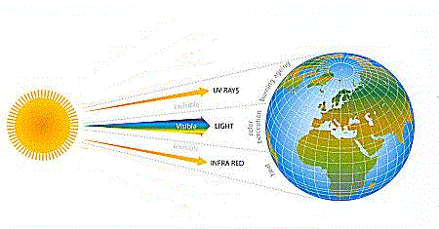
Energy From the Sun
Radiation
Transfer of energy by electromagnetic waves

Slide 19
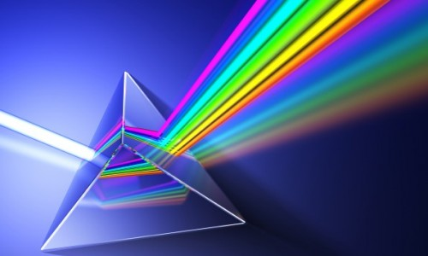
Energy From the Sun
Radiation
Visible light
Light you can see
Converted to thermal energy (heat)

Slide 20
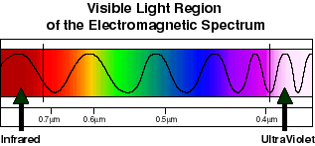
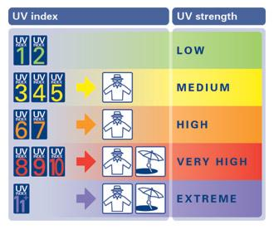
Energy From the Sun
Radiation
Ultraviolet Light-UV
Short wavelengths
Burns human skin
Causes skin cancer

Slide 21
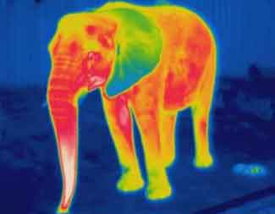
Energy From the Sun
Radiation
Infrared Light-IR
Longer wavelengths
Felt as warmth

Slide 22
Energy on Earth

Slide 23
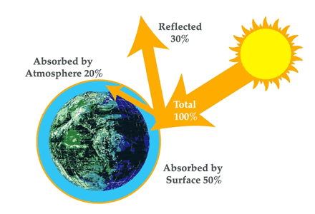
Energy on Earth
Absorption
20% of sun’s radiation absorbed by particles in atmosphere
50% of sun’s radiation absorbed by Earth’s surface
Reflection
25% of sun’s radiation is reflected by clouds and particles
5% of sun’s radiation is reflected by land and sea surfaces

Slide 24
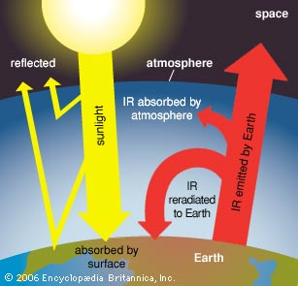
Energy From the Sun
Radiation Balance
Amount of radiation earth receives from sun is the same as the amount radiated back into the atmosphere

Slide 25
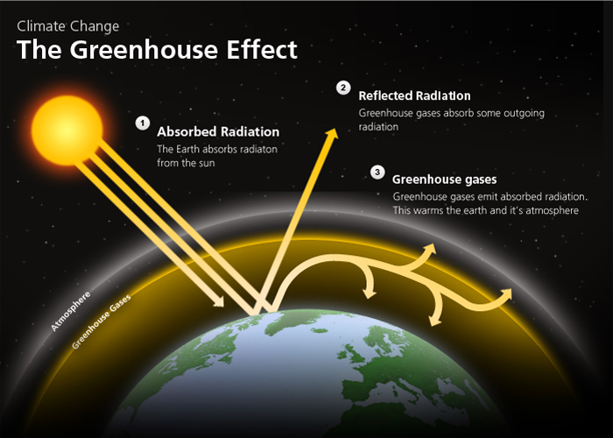
Energy From the Sun
Greenhouse Gases
Greenhouse gases=water vapor, carbon dioxide and methane
Gases in atmosphere let in sunlight
Gases trap some radiation and direct it back to earth
Radiation builds up on earth’s surface as thermal energy

